Slide 1
British Airways
Web Scraping for Customer Reviews

Slide 2
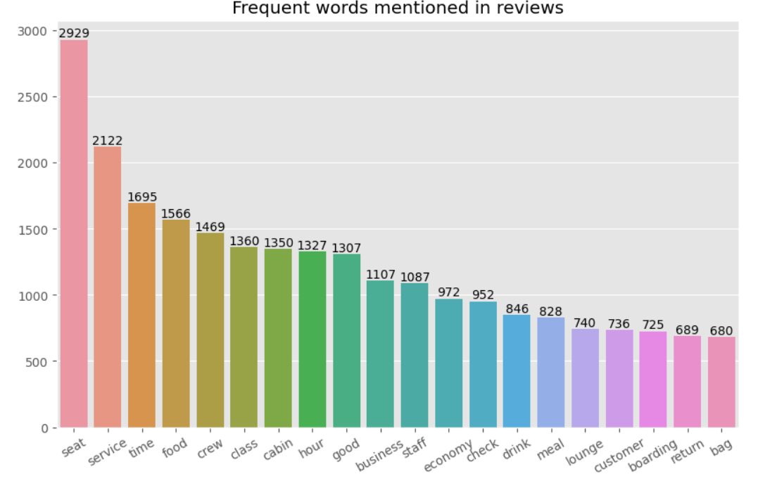
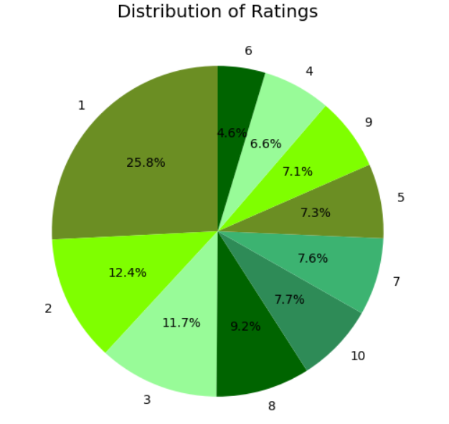
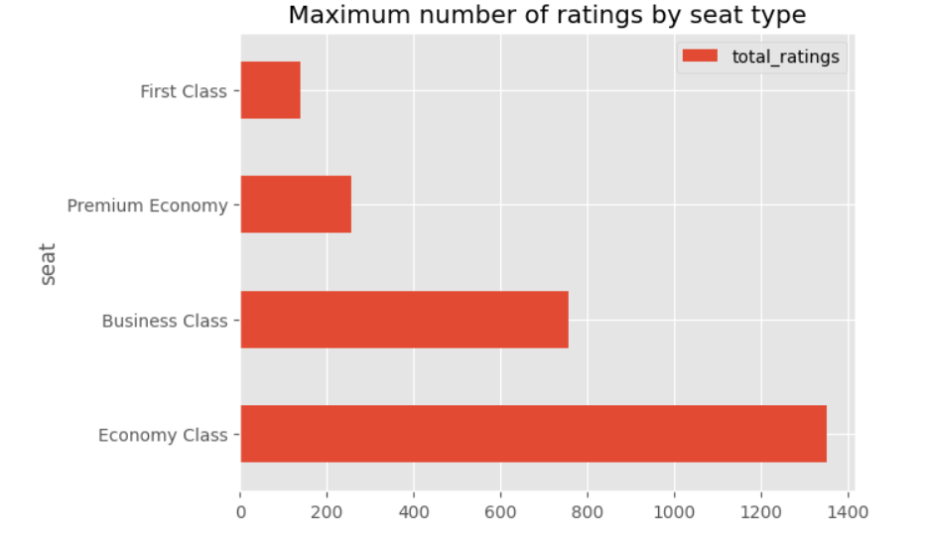
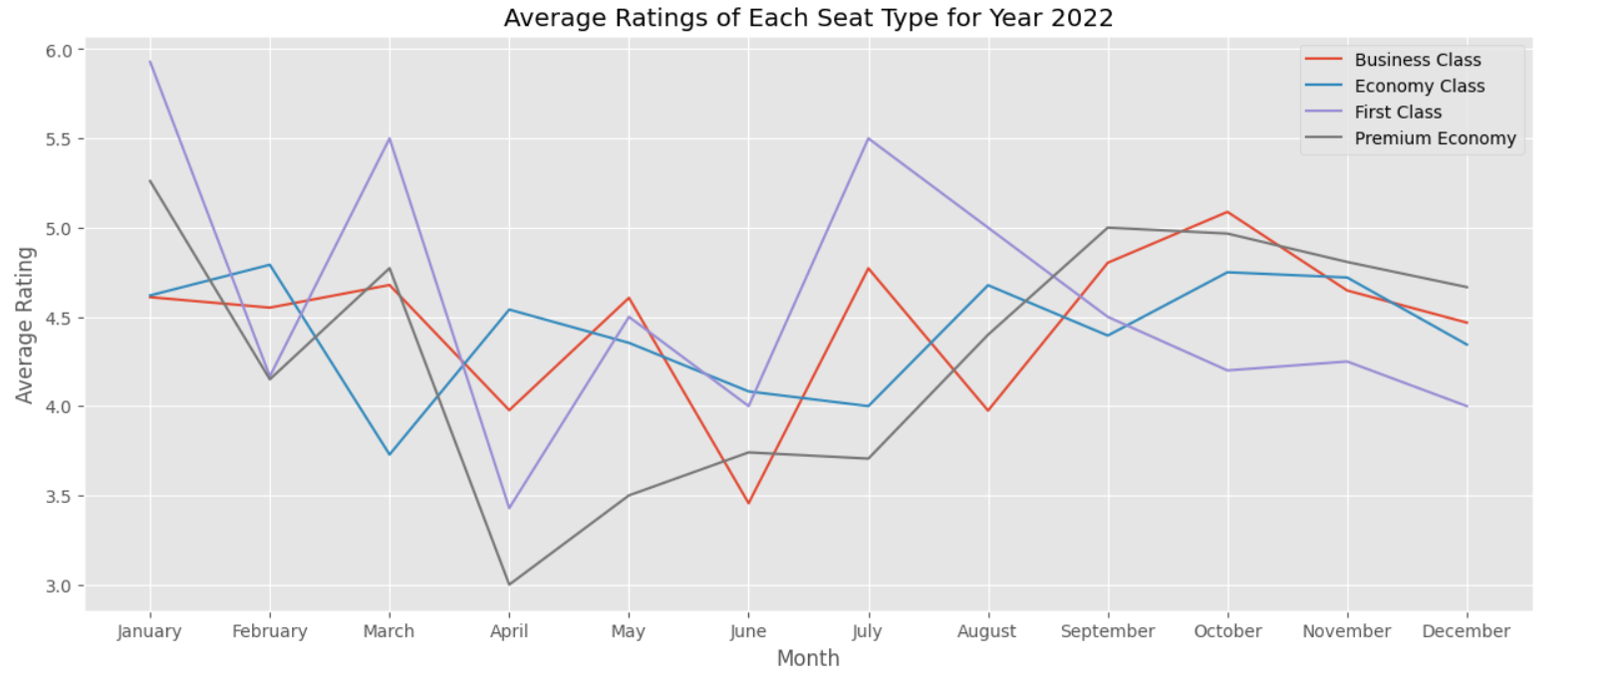
Average Overall Rating for BA
4.23/10
2500 Total Reviews Collected
The majority of passengers who provided a review were travelling in the economy class.
Focus on the frequent words used in reviews
Reviews for different ratings range:
1-3: Passengers were satisfied with the deal voucher offered by BA and mentioned BA being a low cost carrier. Some were disappointed with the overall service provided and due to air traffic controller strike/delayed.
4-6: People complaint about the middle seat being blocked and bad business class experience. A few were happy that their flight landed early.
7-9: Some proved dissatisfaction due to long haul flight while others found the cabin crew friendly and the food decent.

